Slide 1

Digital Electronics and Computer Architecture (DECA)
Digital Electronics (Unit-3):
(Complete Unit)
Computer Organization: Introduction to Computer Organization &
Architecture, Basic Computer Organization, Instruction Codes, Computer Registers, Computer Instructions, Memory, Reference, Register Reference and I/O Instructions, instruction Set
Completeness, Timing and Control, Instruction Cycle, Process to determine the type of
instructions, Input-Output and Program Interrupts.
B.E.-CSE 1st Sem.
Department of Interdisciplinary Courses in Engineering (DICE)
&
Department of Computer Science and Engineering

Slide 2
INTRODUCTION TO COMPUTER ORGANIZATION

Slide 3
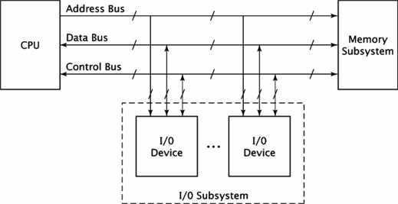
BASIC COMPUTER ORGANIZATION:
The basic computer organization has three main components:
CPU
Memory subsystem
I/O subsystem.
The generic organization of these components is shown in the figure below.
Fig 1.1 Generic computer Organization

Slide 4
System bus:
Physically the bus is a set of wires. The components of a computer are connected to the buses. To send information from one component to another the source component outputs data on to the bus. The destination component then inputs the data from bus.
The system has three buses
Address bus
Data bus
Control bus
The uppermost bus in this figure is the address bus. When the CPU reads data or instructions from or writes data to memory, it must specify the address of the memory location it wishes to access.
Data is transferred via the data bus. When CPU fetches data from memory it first outputs the memory address on to its address bus. Then memory outputs the data onto the data bus. Memory then reads and stores the data at the proper locations.
Control bus carries the control signal. Control signal is the collection of individual control signals. These signals indicate whether data is to be read into or written out of the CPU.

Slide 5
CPU ORGANIZATION:
Central processing unit (CPU) is the electronic circuitry within a computer that carries out the instructions of a computer program by performing the basic arithmetic, logical, control and input/output (I/O) operations specified by the instructions.
In the computer all the major components are connected with the help of the system bus.
Data bus : Data bus is used to shuffle data between the various components in a computer system.
Address bus : To differentiate memory locations and I/O devices the system designer assigns a unique memory address to each memory element and I/O device. When the software wants to access some particular memory location or I/O device it places the corresponding address on the address bus. Circuitry associated with the memory or I/O device recognizes this address and instructs the memory or I/O device to read the data from or place data on the data bus. Only the device whose address matches the value on the address bus responds.
Control bus : The control bus is an eclectic collection of signals that control how the processor communicates with the rest of the system. The read and write control lines control the direction of data on the data bus

Slide 6
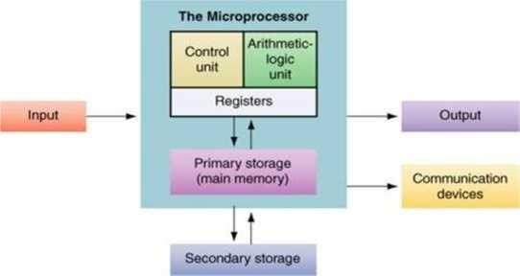
When both contain logic one the CPU and memory-I/O are not communicating with one another.
If the read line is low (logic zero) the CPU is reading data from memory (that is the system is transferring data from memory to the CPU).
If the write line is low the system transfers data from the CPU to memory.
The CPU controls the computer. It fetches instructions from memory, supply the address and control signals needed by the memory to access its data.
Internally, CPU has three sections as shown in the fig below
Fig 1.2: CPU Organization

Slide 7
The register section, as its name implies, includes a set of registers and a bus or other communication mechanism.
The register in a processor’s instruction set architecture are found in the section of the CPU.
The system address and data buses interact with this section of CPU. The register section also contains other registers that are not directly accessible by the programmer.
The fetch portion of the instruction cycle, the processor first outputs the address of the instruction onto the address bus. The processor has a register called the “program counter”.
The CPU keeps the address of the next instruction to be fetched in this register. Before the CPU outputs the address on to the system bus, it retrieves the address from the program counter register.
At the end of the instruction fetch, the CPU reads the instruction code from the system data bus.
It stores this value in an internal register, usually called the “instruction register”.
The arithmetic / logic unit (or) ALU performs most arithmetic and logic operations such as adding and ANDing values. It receives its operands form the register section of the CPU and stores its result back in the register section.

Slide 8
Just as CPU controls the computer, the control unit controls the CPU. The control unit receives some data values from the register unit, which it used to generate the control signals. This code generates the instruction codes & the values of some flag registers.
The control unit also generates the signals for the system control bus such as READ, WRITE, I/O signals.

Slide 9
Instruction Codes

Slide 10
Instruction Codes
The organization of the computer is defined by its internal registers, the timing and control structure, and the set of instructions that it uses.
A computer instruction is a binary code that specifies a sequence of micro-operations for the computer.
An instruction code is a group of bits that instruct the computer to perform a specific operation.
Instruction code is usually divided into two parts.
Operation part - Group of bits that define such operations as add, subtract, multiply, shift, and complement.
Address part - Contains registers or memory words where the address of operand is found or the result is to be stored.
Each computer has its own instruction code format.

Slide 11
Operation Code
The operation code (op-code) of an instruction is a group of bits that define such operations as add, subtract, multiply, shift, and complement.
The number of bits required for the operation code of an instruction depends on the total number of operations available in the computer (n bits for 2^{n} operations).

Slide 12
Stored Program Organization
Simplest way to organize computer is to have one processor register(Accumulator AC) and an instruction code format with two parts:
First-Operation to be performed
Second – Address
The memory address tells the control where to find an operand in memory.
This operand is read from memory and used as the data to be operated on together with the data stored in the processor register.

Slide 13
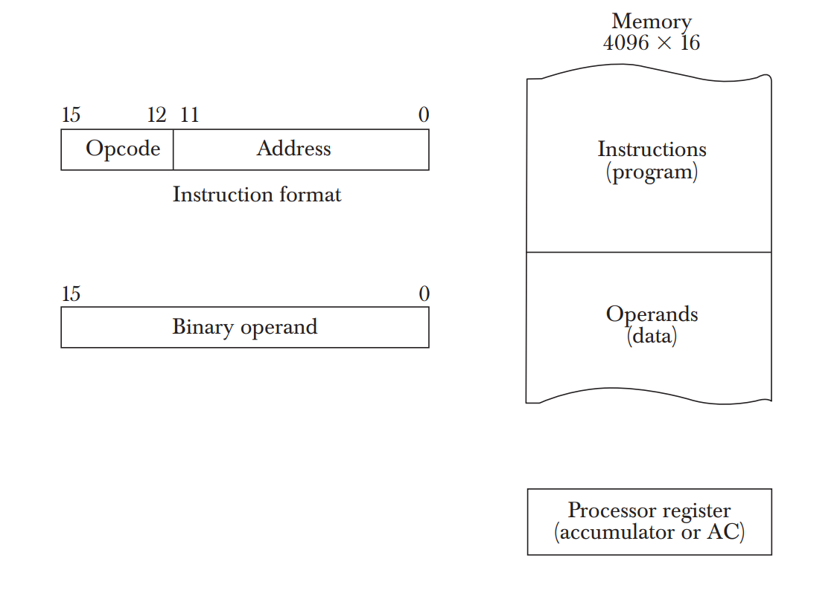
Stored Program Organization
Instructions are stored in one section of the memory and data in another.
For a memory unit with 4096 words we need 12 bits to specify an address since 2¹²=4096.
4 bits are available for opcode to specify one out of 16 possible operations.

Slide 14
Steps
The control reads a 16-bit instruction from the program portion of memory.
It uses the 12-bit address part of the instruction to read a 16-bit operand from the data portion of memory.
It then executes the operation specified by the operation code.
The operation is performed with the memory operand and the content of AC.

Slide 15
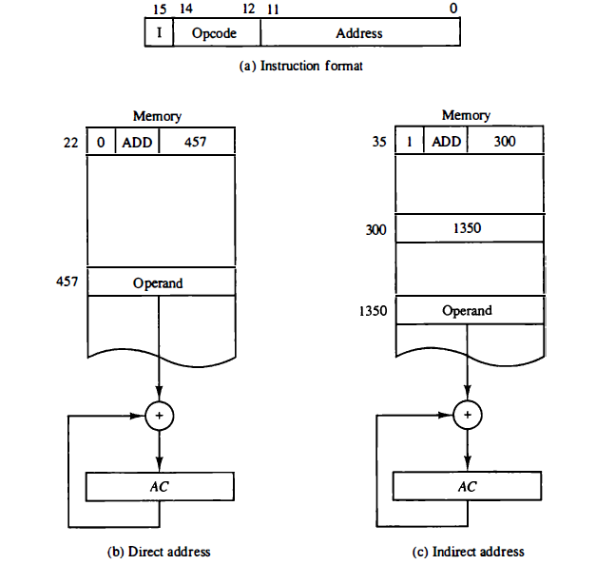
Direct and Indirect Addressing Modes
Following Addressing Modes are used for address portion of the instruction code.
Immediate- The address part specifies an operand. Eg: ADD 5
Direct- The address part specifies the address of an operand.
Indirect- The address part specifies a pointer(another address) where the address of the operand can be found.
One bit of the instruction code(I) can be used to distinguish between a direct and an indirect address.

Slide 16
Effective Address
It is the address of the operand in a computation-type instruction or the target address in a branch-type instruction.
The effective address in the instruction of the figures are 457 and 1350.

Slide 17
Computer Registers

Slide 18
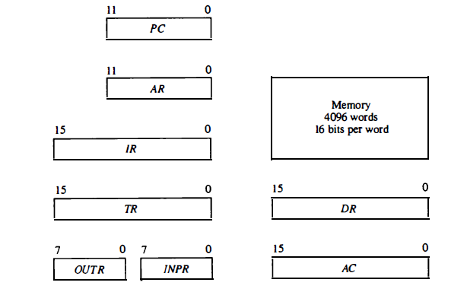
Basic Computer Registers and Memory

Slide 19
Computer Registers
Need of Registers?
Computer instructions are normally stored in consecutive memory locations and are executed sequentially one at a time.
The control reads an instruction from a specific address in memory and executes it. It then continues by reading the next instruction in sequence and executes it, and so on.
This type of instruction sequencing needs a counter to calculate the address of the next instruction after execution of the current instruction is completed.
It is also necessary to provide a register in the control unit for storing the instruction code after it is read from memory.
The computer needs processor registers for manipulating data and a register for holding a memory address.

Slide 20
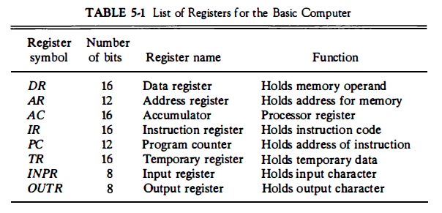
List of Registers for Basic Computer

Slide 21
Computer Instructions

Slide 22
Instruction Format
The basic computer has three instruction code formats each having 16 bits:
Memory reference instructions
Register reference instructions
I/O instructions
The opcode part of the instruction contains three bits and the meaning of the remaining 13 bits depends on the operation code encountered.

Slide 23

Memory Reference Instructions
Bits 0-11 for specifying address.
Bits 12-14 for Opcode.
15th bit specifies addressing modes. (0 for direct and 1 for indirect)

Slide 24

Register Reference Instructions
Recognized by the operation code 111 with a 0 in the 15th bit of the instruction.
Specifies an operation on or a test of the AC register.
An operand from memory is not needed.
Therefore the 12 bits are used to specify the operation to be executed.
Eg:
CLA - 7800 : Clear AC
CLE - 7400 : Clear E

Slide 25

Input-Output Instructions
These instructions are needed for transferring information to and from AC register.
Recognized by the opcode 111 and a 1 in the 15th bit.
Bits 0-11 specify the type of I/O Operation performed.
Eg:
INP - F800 : Input characters to AC
OUT - F400 : Output characters from AC

Slide 26
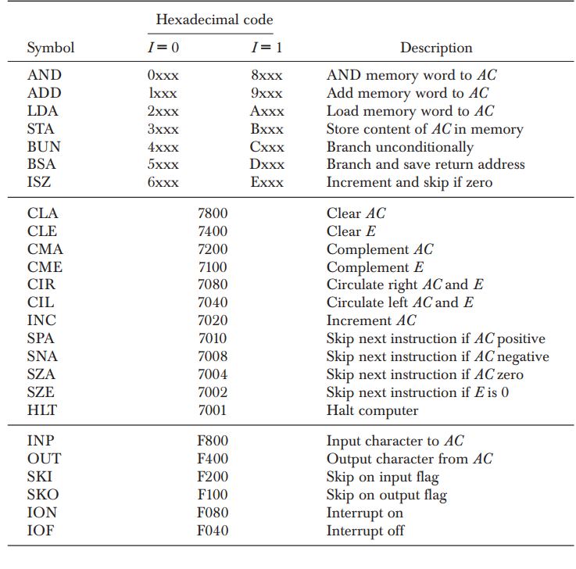
Basic Computer Instructions

Slide 27
Instruction Set Completeness
The set of instructions are said to be complete if the computer includes a sufficient number of instructions in each of the following categories:
Arithmetic, logical, and shift instructions.
Instructions for moving information to and from memory and processor registers.
Program control instructions.
Input and output instructions.

Slide 28
Timing and Control
The timing for all register in computer is controlled by a master clock generator.
Control signals are generated in the control unit and provide control inputs for the multiplexers, common bus, processor registers, and accumulator.
Two major types of control organizations:
-Hardwired Control
- Microprogrammed Control
Hardwired control is implemented with gates, flip-flops, decoders, and other digital circuits.
In microprogrammed control, control information is stored in control memory, and any required change or modification can be done by updating the microprogram in the control memory.

Slide 29
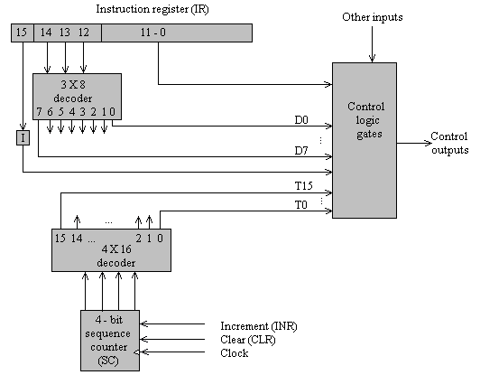
Hardwired Control unit of basic Computer
.

Slide 30
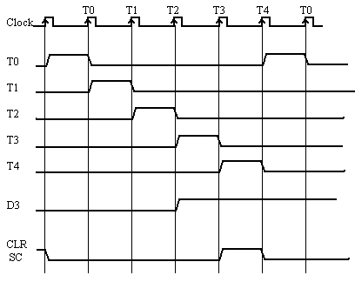
Example of Control Timing Signals
. At time T4, SC is cleared to 0 if decoder output D3 is active.
D3T4: SC←0

Slide 31
Instruction Cycle
A program residing in the memory unit of computer consists of a sequence of instructions.
The program is executed in the computer by going through a cycle for each instruction.
Each instruction cycle is subdivided into sequence of subcycles of phases.
1. Fetch an instruction from memory
2. Decode the instruction
3. Read the effective address from memory if the information has an indirect address.
4. Execute the instruction
Upon completion of step 4, control goes back to step 1 to fetch, decode and execute the next instruction.
This process continues indefinitely unless a HALT instruction is encountered.

Slide 32

Fetch and Decode
Initially program counter PC is loaded with the address of first instruction in the program. And sequence counter (SC) is cleared to 0.
After each clock pulse, SC is incremented by 1.
The micro operations for the fetch and decode phase can be specified by following register transfer statement.

Slide 33
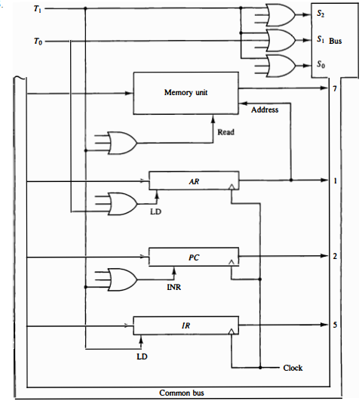
Cont…
.
Place the content of PC onto the bus by making the bus selection inputs S2 S1 S0=010.
Transfer the content of the bus to AR.

Slide 34
Process to Determine the Type of Instruction
During time T3, the control unit determines the type of instruction that was just read from the memory.
Purpose is to determine the type of instruction by control unit whether it is
i. Memory Reference Instruction
ii. Register Reference Instruction
iii. I/O Instruction

Slide 35
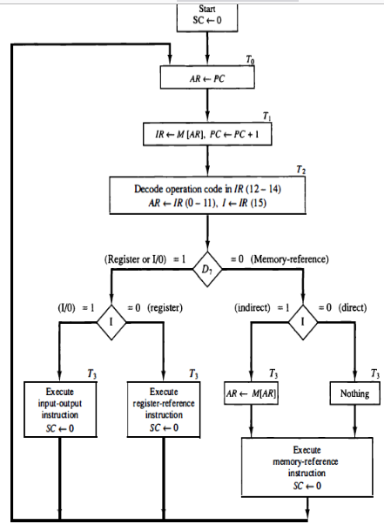
Determine the Type of Instruction- Flow Chart
.

Slide 36
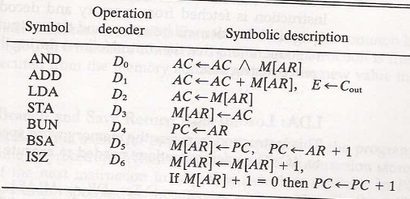
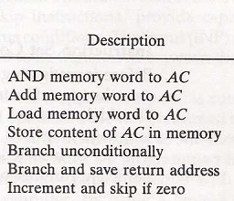
Memory reference instruction

Slide 37
Memory reference instruction
Memory reference instructions are those commands or instructions which are in the custom to generate a reference to the memory and approval to a program to have an approach to the commanded information and that states as to from where the data is cache continually. These instructions are known as Memory Reference Instructions.
There are seven memory reference instructions which are as follows &
AND
The AND instruction implements the AND logic operation on the bit collection from the register and the memory word that is determined by the effective address. The result of this operation is moved back to the register.
ADD
The ADD instruction adds the content of the memory word that is denoted by the effective address to the value of the register.

Slide 38
LDA
The LDA instruction shares the memory word denoted by the effective address to the register.
STA
STA saves the content of the register into the memory word that is defined by the effective address. The output is next used to the common bus and the data input is linked to the bus. It needed only one micro-operation.
BUN
The Branch Unconditionally (BUN) instruction can send the instruction that is determined by the effective address. They understand that the address of the next instruction to be performed is held by the PC and it should be incremented by one to receive the address of the next instruction in the sequence. If the control needs to implement multiple instructions that are not next in the sequence, it can execute the BUN instruction.

Slide 39
Memory reference instruction
BSA
BSA stands for Branch and Save return Address. These instructions can branch a part of the program (known as subroutine or procedure). When this instruction is performed, BSA will store the address of the next instruction from the PC into a memory location that is determined by the effective address.
ISZ
The Increment if Zero (ISZ) instruction increments the word determined by effective address. If the incremented cost is zero, thus PC is incremented by 1. A negative value is saved in the memory word through the programmer. It can influence the zero value after getting incremented repeatedly. Thus, the PC is incremented and the next instruction is skipped.

Slide 40

1. AND to AC
This is an instruction that performs the AND logic operation on pair of bits in AC and the Memory word specified by effective address.
The result of the operation is transferred to AC.
The microoperation performed this operation are:
Total time cycle = 6

Slide 41

2. ADD to AC
This instruction adds the content of memory word specified by effective address to the value to AC.
The sum is transferred to AC and the output carry Cout is transferred to the E (extended AC) flip-flop.
The microoperation performed this operation are:
Total time cycle = 6

Slide 42

3. LDA : Load to Ac
This instruction transferred the content of memory word specified by effective address to the AC.
The microoperation performed this operation are:
Total time cycle = 6

Slide 43

4. STA : Store AC
This instruction store the content of AC in to the memory word specified by effective address .
The microoperation performed this operation are:
Total time cycle = 5

Slide 44

5. BUN: Branch Unconditionally
This instruction transfers the program to the instruction specified by the effective address. PC holds the address of instruction to be read from memory in the next instruction cycle.
It allows the programmer to specify an instruction out of sequence.
The microoperation performed this operation are:
Total time cycle = 5

Slide 45

6. BSA: Branch and Save return Address
This instruction is useful for branching to a portion of the program called a subroutine or procedure.
1st it stores the address of next instruction in sequence into memory location specified by effective address. Then effective address plus one is transferred to PC to serve the address of next instruction.
The microoperation performed this operation are:
Total time cycle = 6

Slide 46
Input-Output and Interrupt

Slide 47
Introduction
A Computer can serve no useful purpose unless it communicates with the external environment.
Instructions and data stored in memory must come from some input device.
Computational results must be transmitted to user through some output device.
Commercial computers include many types of input and output devices.
To demonstrate the most basic requirements for input and output communication, we will use as a illustration a terminal unit with a keyboard and printer.

Slide 48
Input-Output Configuration
The terminal sends and receives serial information.
Each quantity of information has eight bits of an alphanumeric code.
The serial information from the keyboard is shifted into the input register INPR.
The serial information for printer is stored in output register OUTR.
These two registers communicate with communication interface serially and with the AC in parallel.

Slide 49
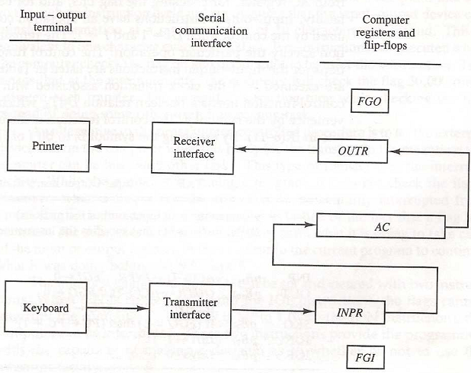
Input-Output Configuration

Slide 50
Input-Output Flags
1 bit input flag FGI is a control flip-flop. The flag bit is 1 when new information is available in input device and cleared to zero when accepted by computer.
Flag is used to synchronize the timing rate difference between input device and computer.
Initially FGI is set to 0. when a key is struck in the keyboard, an 8-bit alphanumeric code is shifted in to INPR and the input flag FGI is set to 1.
The output register OUTR works similarly but the direction of information flow is reversed.
Initially, the output flag FGO is set to 1.
Computer checks FGO, and if it is 1, the information from AC is transferred in a parallel to OUTR and FGO is cleared to 0.

Slide 51
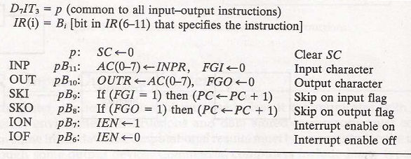
Input-Output Instructions.
For this type of information I=1, and
D7 (i.e. IR(12-14)=111)
For basic Computer only 6 input-output instruction.

Slide 52
Program Interrupt
An alternative to the programmed controlled procedure is to let the external device inform the computer when it is ready for the transfer.
In the meantime computer can be busy with other tasks.
This type of transfer use the interrupt facility. While computer is running the program, it does not check the flags, however when a flag is set then computer receives an interrupt.
The interrupt enable flip-flop IEN can be set and cleared with two instructions.
When IEN is cleared to zero (with IOF instruction), the flag can not interrupt the computer.
When IEN is cleared to 1 (with ION instruction), the computer can be interrupted.

Slide 53
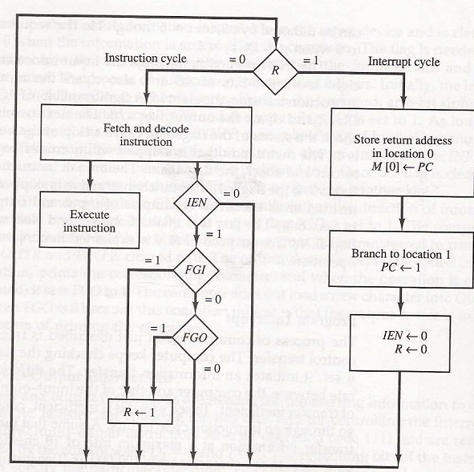
Flowchart of Interrupt cycle

Slide 54
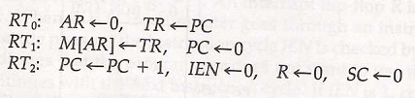
Interrupt cycle
Here the modified fetch and decode phase of interrupt cycles as follow:

Slide 55
Question Practice (Subjective)
1. A computer uses a memory unit with 65536 words of 32 bits each. A binary instruction code is stored in one word of memory. The instruction has four parts: an indirect bit, an operation code, a register code part to specify one of 1024 registers and an address part.
(i). How many bits are there in the operation code, the register part, indirect bit and the address part?
(ii). Draw an instruction word format and indicate the number of bits in each part.
Memory unit with word size 65536, So number of address bits = 16
Resister 1024, Register code 10 bits.
Indirect bit 1 bit.
So, operation code = (32-10-16-1)=5 bits
Total 32 bits.
1 | 5 | 10 | 16
I | Opcode | Register | Address

Slide 56
2. An instruction at address 021 in the basic computer has an address part equal to 083 (all numbers are in hexadecimal). The memory word at address 083 contains the operand C73A and the content of AC (Accumulator) is B239. Determine the contents of the registers at the end of the execute phase: PC (Program Counter), AR (Address Register), AC and IR (Instruction Register). Implement the problem using following operation codes (Hexadecimal code):
i) AND (0083)
ii) CMA (7200)
iii) INC (7800)
iv) BUN (4520)

Slide 57
Ans. 2
Step 1
 | PC | AR | DR | AC | IR
Initial | 021 | 083 | C73A | B239 | 0083
AND
CMA
INC
BUN

Slide 58
Ans. 2
 | PC | AR | DR | AC | IR
Initial | 021 | 083 | C73A | B239 | 0083
AND | 022 | 083 | --- | 8238 | 0083
CMA | 022 | 083 | ---- | 4DC6 | 7200
INC | 022 | 083 | ---- | B23A | 7800
BUN | 083 | 083 |  | B239 | 4520

Slide 59
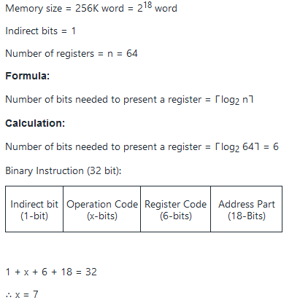
Cont…
.
Q. 3 A computer uses the memory with unit of 256K words of 32 bit each. A binary instruction of code stored one word of the memory. The Instruction has four parts which are Indirect bit, register code, an operation code and address part with 64 registers. How many bit are there in operation code?

Slide 60
Cont..
Q. 4 The content of AC is A937, the content of PC in basic computer is 021, what will the value of AC and PC after performing CIR ?
Answer: hint: CIR-circulate right the contents of accumulator
Content of AC is D49B
content of PC is 022H
.

Slide 61
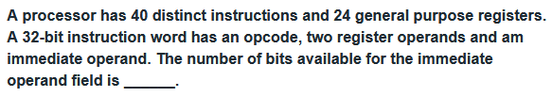
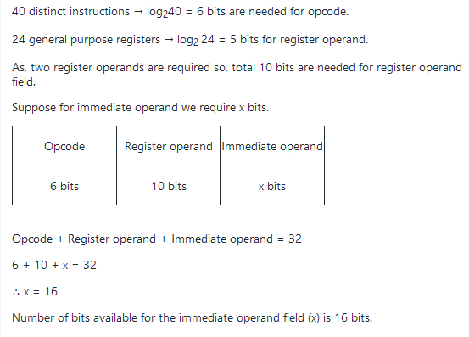
Cont..
Q 5.
.

Slide 62
MCQs
1) Who developed the basic architecture of computer?
a) Blaise Pascal
b) Charles Babbage
c) John Von Neumann
d) None of the above
2) Which of the following allows simultaneous write and read operations?
a) ROM
b) EROM
c) RAM
d) None of the above

Slide 63
3) Which of the following is not considered as a peripheral device?
a)CPU
b)Keyboard
c)Monitor
d)All of the above
4) Computer address bus is -
a)Multidirectional
b)Bidirectional
c)Unidirectional
d)None of the above

Slide 64
5) Which of the following is a way in which the components of a computer are connected to each other?
a)Computer parts
b)Computer architecture
c)Computer hardware
d)None of the above
6) Which of the following computer bus connects the CPU to a memory on the system board?
a) Expansion bus
b) Width bus
c) System bus
d)None of the above

Slide 65
7) Which of the following memory unit communicates directly with the CPU?
a) Auxiliary memory
b) Main memory
c) Secondary memory
d) None of the above
8) In which of the following form the computer stores its data in memory?
a) Hexadecimal form
b) Octal form
c) Binary form
d) Decimal form

Slide 66
9. MRI Indicates
Memory Reference Information
Memory Reference Instruction
Memory Registers Instruction
Memory Registers Information
10. A group of bits that tell the computer to perform a specific operation is known as
a) Instruction code
b) Micro-operation
c) Accumulator
d) Register

Slide 67
Answer Key
C
C
A
C
B
C
B
C
B
A

Slide 68
Thank You

